Slide 1

Theme Switcher & Calculator
Diego

Slide 2
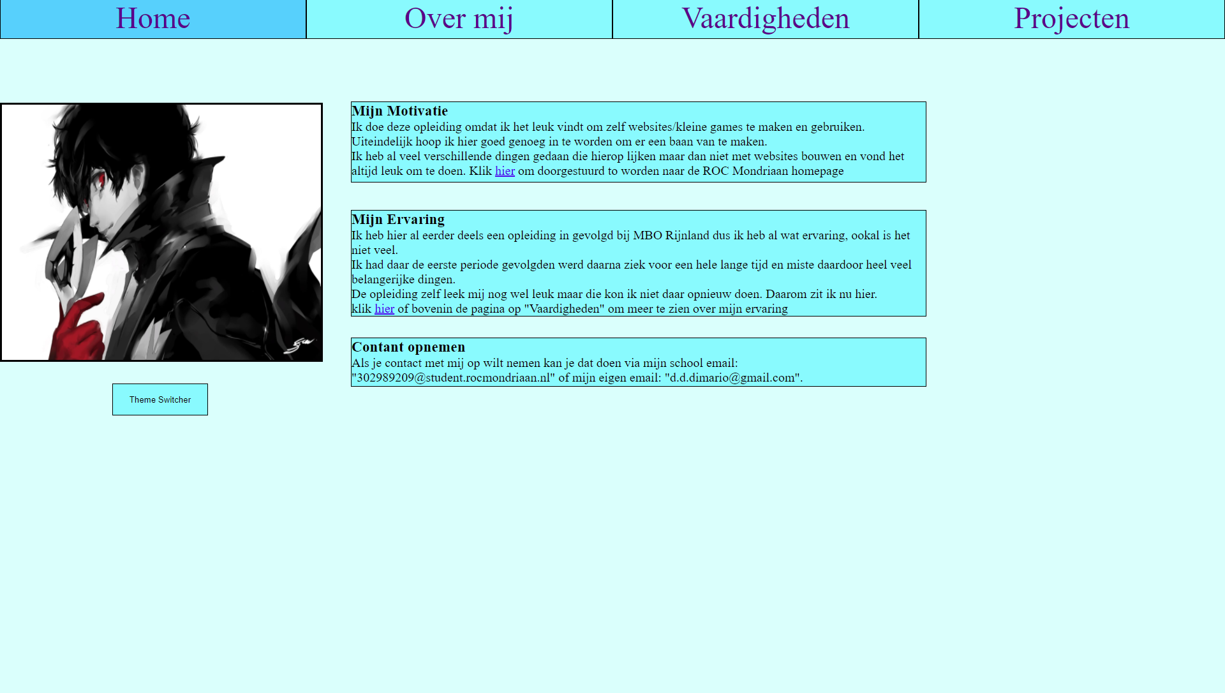
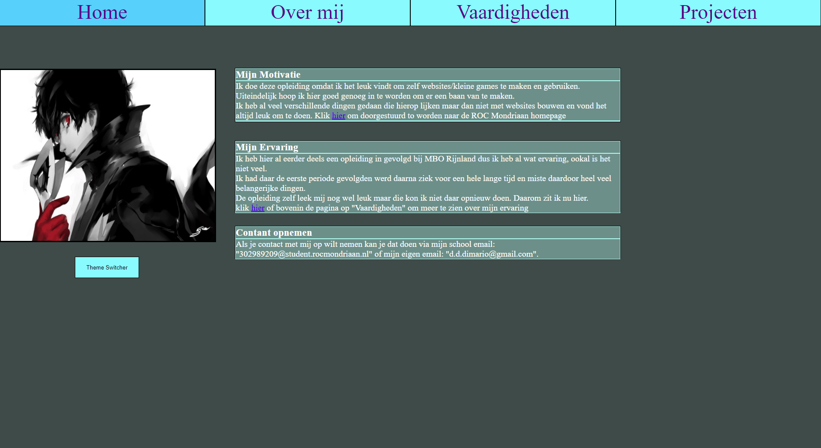
Thema Switcher
Before & After

Slide 3
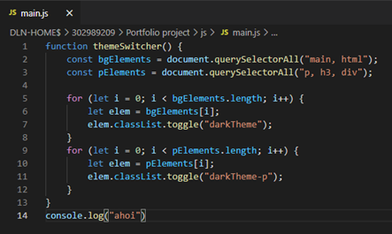
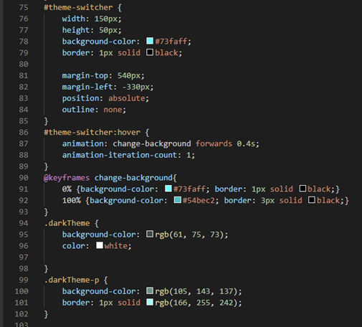
Thema Switcher

Slide 4
Calculator

Slide 5
Einde

